Slide 1
Inference on Categorical Data
Copyright © 2017, 2013, 2010 Pearson Education, Inc. All Rights Reserved

Slide 2
Goodness-of-Fit Test Learning Objective
1. Perform a goodness-of-fit test

Slide 3
Goodness-of-Fit Test Perform a goodness-of-fit test (1 of 32)
Characteristics of the Chi-Square Distribution
It is not symmetric.
It’s shape depends on the degrees of freedom, just like Student’s t-distribution.
As the number of degrees of freedom increases, it becomes more nearly symmetric.

Slide 4
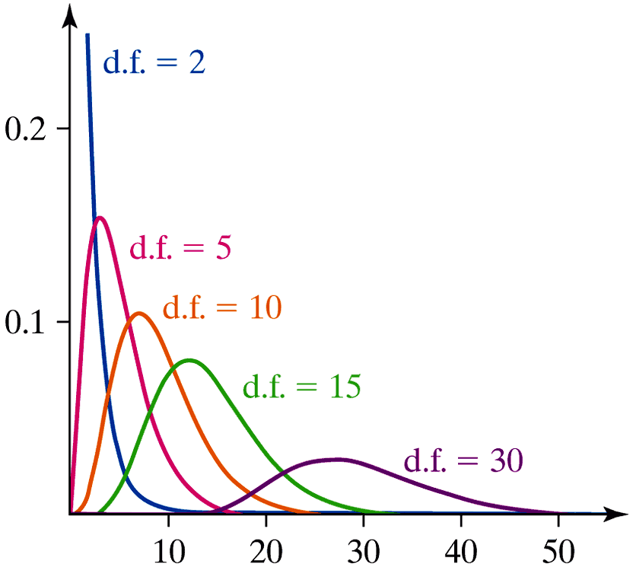
Goodness-of-Fit Test Perform a goodness-of-fit test (2 of 32)

Slide 5
Goodness-of-Fit Test Perform a goodness-of-fit test (3 of 32)
A goodness-of-fit test is an inferential procedure used to determine whether a frequency distribution follows a specific distribution.

Slide 6
Goodness-of-Fit Test Perform a goodness-of-fit test (10 of 32)
The Goodness-of-Fit Test
To test the hypotheses regarding a distribution, we use the steps that follow.
Step 1: Determine the null and alternative hypotheses.
H₀: The random variable follows a certain distribution
H₁: The random variable does not follow the distribution in the null hypothesis

Slide 7
Goodness-of-Fit Test Perform a goodness-of-fit test (11 of 32)
Step 2: Decide on a level of significance, α, depending on the seriousness of making a Type I error.

Slide 8
Goodness-of-Fit Test Perform a goodness-of-fit test (12 of 32)
Step 3:
Calculate the expected counts, E_{i} , for each of the k categories. The expected counts are E_{i} = np_{i} for i = 1, 2, … , k where n is the number of trials and p_{i} is the probability of the ith category, assuming that the null hypothesis is true.

Slide 9
Goodness-of-Fit Test Perform a goodness-of-fit test (13 of 32)
Step 3:
Verify that the requirements for the goodness-of-fit test are satisfied.
All expected counts are greater than or equal to 1 (all E_{i} ≥ 1).
No more than 20% of the expected counts are less than 5.

Slide 10
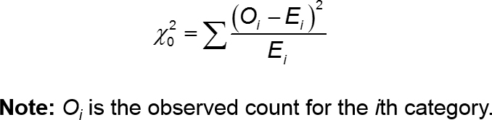
Goodness-of-Fit Test Perform a goodness-of-fit test (18 of 32)
P-value Approach
By Hand Step 3 (continued):
c) Compute the test statistic:

Slide 11
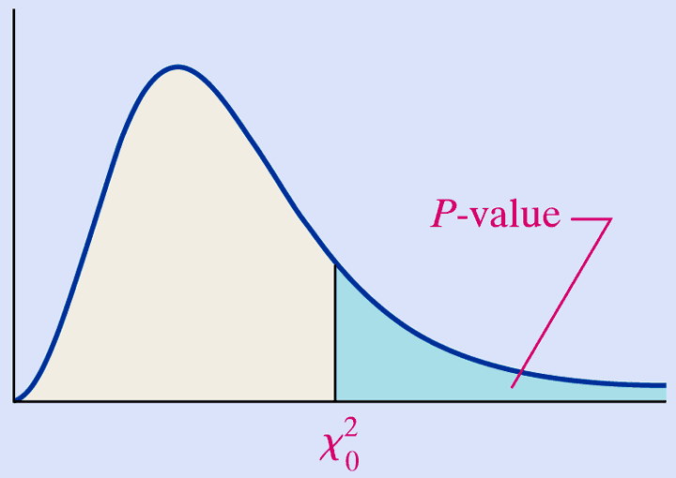
Goodness-of-Fit Test Perform a goodness-of-fit test (19 of 32)
P-value Approach
Use Table VIII to approximate the P-value by determining the area under the chi-square distribution with k − 1 degrees of freedom to the right of the test statistic.

Slide 12
Goodness-of-Fit Test Perform a goodness-of-fit test (21 of 32)
P-value Approach
Step 4: If the P-value < α, reject the null hypothesis.

Slide 13
Goodness-of-Fit Test Perform a goodness-of-fit test (22 of 32)
P-value Approach
Step 5: State the conclusion.

Slide 14
Goodness-of-Fit Test Perform a goodness-of-fit test (23 of 32)
Parallel Example 2: Conducting a Goodness-of-Fit Test
A sociologist wishes to determine whether the distribution for the number of years care-giving grandparents are responsible for their grandchildren is different today than it was in 2000.
According to the United States Census Bureau, in 2000, 22.8% of grandparents have been responsible for their grandchildren less than 1 year; 23.9% of grandparents have been responsible for their grandchildren for 1 or 2 years; 17.6% of grandparents have been responsible for their grandchildren 3 or 4 years; and 35.7% of grandparents have been responsible for their grandchildren for 5 or more years. The sociologist randomly selects 1,000 care-giving grandparents and obtains the following data.

Slide 15
Goodness-of-Fit Test Perform a goodness-of-fit test (24 of 32)
Number of Years | Frequency
Less than 1 year | 252
1 or 2 years | 255
3 or 4 years | 162
5 or more years | 331
Test the claim that the distribution is different today than it was in 2000 at the α = 0.05 level of significance.

Slide 16
Goodness-of-Fit Test Perform a goodness-of-fit test (25 of 32)
Solution
Step 1: We want to know if the distribution today is different than it was in 2000. The hypotheses are then:
H₀: The distribution for the number of years care-giving grandparents are responsible for their grandchildren is the same today as it was in 2000
H₁: The distribution for the number of years care-giving grandparents are responsible for their grandchildren is different today than it was in 2000

Slide 17
Goodness-of-Fit Test Perform a goodness-of-fit test (26 of 32)
Solution
Step 2: The level of significance is α = 0.05.
Step 3:
The expected counts were computed in Example 1.
Number of Years | Observed Counts | Expected Counts
<1 | 252 | 228
1-2 | 255 | 239
3-4 | 162 | 176
≥5 | 331 | 357

Slide 18
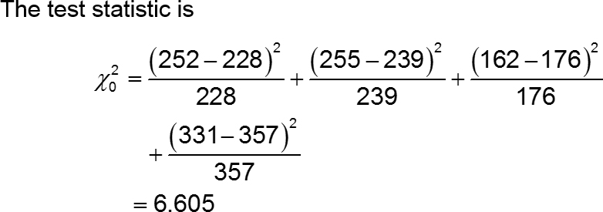
Goodness-of-Fit Test Perform a goodness-of-fit test (27 of 32)
Solution
Step 3:
Since all expected counts are greater than or equal to 5, the requirements for the goodness-of-fit test are satisfied.

Slide 19
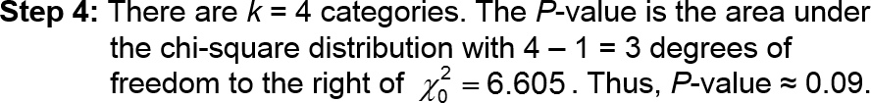
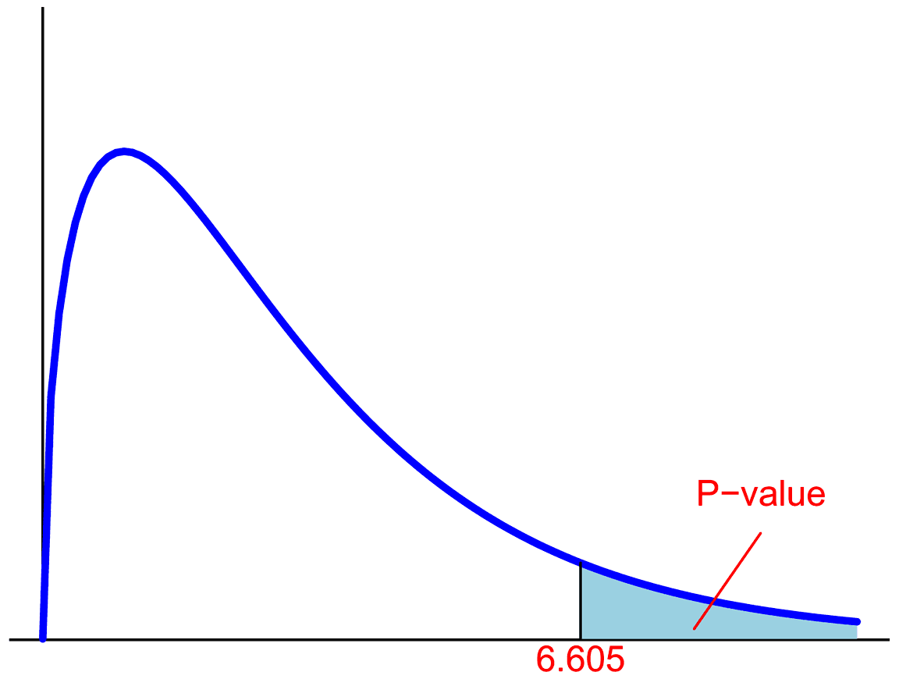
Goodness-of-Fit Test Perform a goodness-of-fit test (30 of 32)
Solution: P-value Approach

Slide 20
Goodness-of-Fit Test Perform a goodness-of-fit test (31 of 32)
Solution: P-value Approach
Since the P-value ≈ 0.09 is greater than the level of significance α = 0.05, we fail to reject the null hypothesis.

Slide 21
Goodness-of-Fit Test Perform a goodness-of-fit test (32 of 32)
Solution
Step 5: There is insufficient evidence to conclude that the distribution for the number of years care-giving grandparents are responsible for their grandchildren is different today than it was in 2000 at the α = 0.05 level of significance.

Slide 22
Comparing Three or More Means (One-Way Analysis of Variance) Learning Objectives
1. Verify the requirements to perform a one-way ANOVA
2. Test a hypothesis regarding three or more means using one-way ANOVA

Slide 23
Introduction to the Practice of Statistics Introduction (1 of 2)
Analysis of Variance (ANOVA) is an inferential method used to test the equality of three or more population means.

Slide 24
Introduction to the Practice of Statistics Introduction (2 of 2)
CAUTION!
Do not test H₀: μ₁ = μ₂ = μ₃ by conducting three separate hypothesis tests, because the probability of making a Type I error will be much higher than α.

Slide 25
Introduction to the Practice of Statistics Verify the requirements to perform a one-way ANOVA (1 of 12)
Requirements of a One-Way ANOVA Test
There must be k simple random samples; one from each of k populations or a randomized experiment with k treatments.
The k samples are independent of each other; that is, the subjects in one group cannot be related in any way to subjects in a second group.
The populations are normally distributed.
The populations must have the same variance; that is, each treatment group has the population variance σ².

Slide 26
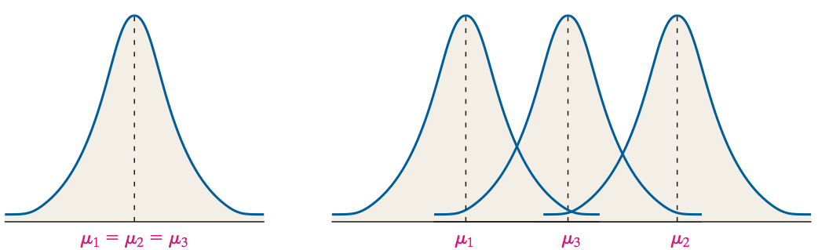
Introduction to the Practice of Statistics Verify the requirements to perform a one-way ANOVA (2 of 12)
Testing a Hypothesis Regarding k = 3
H₀: μ₁ = μ₂ = μ₃
H₁: At least one population mean is different from the others

Slide 27
Introduction to the Practice of Statistics Verify the requirements to perform a one-way ANOVA (4 of 12)
Verifying the Requirement of Equal Population Variance
The one-way ANOVA procedures may be used if the largest sample standard deviation is no more than twice the smallest sample standard deviation.

Slide 28
Introduction to the Practice of Statistics Verify the requirements to perform a one-way ANOVA (5 of 12)
Parallel Example 1: Verifying the Requirements of ANOVA
The following data represent the weight (in grams) of pennies minted at the Denver mint in 1990,1995, and 2000. Verify that the requirements in order to perform a one-way ANOVA are satisfied.

Slide 29
Introduction to the Practice of Statistics Verify the requirements to perform a one-way ANOVA (6 of 12)
1990 | 1995 | 2000
2.50 | 2.52 | 2.50
2.50 | 2.54 | 2.48
2.49 | 2.50 | 2.49
2.53 | 2.48 | 2.50
2.46 | 2.52 | 2.48
2.50 | 2.50 | 2.52
2.47 | 2.49 | 2.51
2.53 | 2.53 | 2.49
2.51 | 2.48 | 2.51
2.49 | 2.55 | 2.50
2.48 | 2.49 | 2.52

Slide 30
Introduction to the Practice of Statistics Verify the requirements to perform a one-way ANOVA (7 of 12)
Solution
The 3 samples are simple random samples.
The samples were obtained independently.
Normal probability plots for the 3 years follow. All of the plots are roughly linear so the normality assumption is satisfied.

Slide 31
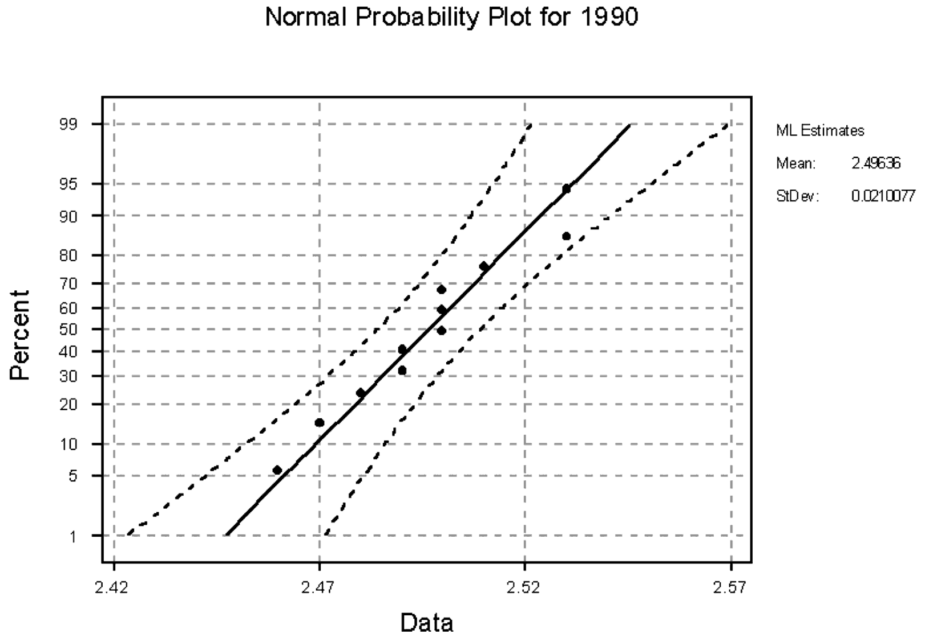
Introduction to the Practice of Statistics Verify the requirements to perform a one-way ANOVA (8 of 12)

Slide 32

Introduction to the Practice of Statistics Verify the requirements to perform a one-way ANOVA (9 of 12)

Slide 33

Introduction to the Practice of Statistics Verify the requirements to perform a one-way ANOVA (10 of 12)

Slide 34
Introduction to the Practice of Statistics Test a Hypothesis Regarding Three or More Means Using One-Way ANOVA (1 of 14)
The basic idea in one-way ANOVA is to determine if the sample data could come from populations with the same mean, μ, or suggests that at least one sample comes from a population whose mean is different from the others.
To make this decision, we compare the variability among the sample means to the variability within each sample.

Slide 35
Introduction to the Practice of Statistics Test a Hypothesis Regarding Three or More Means Using One-Way ANOVA (2 of 14)
We call the variability among the sample means the between-sample variability, and the variability of each sample the within-sample variability.
If the between-sample variability is large relative to the within-sample variability, we have evidence to suggest that the samples come from populations with different means.

Slide 36
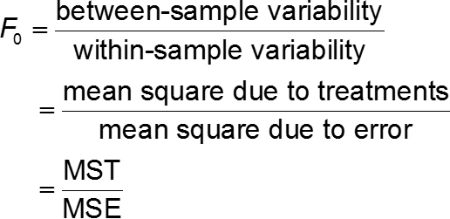
Introduction to the Practice of Statistics Test a Hypothesis Regarding Three or More Means Using One-Way ANOVA (3 of 14)
ANOVA F-Test Statistic

Slide 37
Introduction to the Practice of Statistics Test a Hypothesis Regarding Three or More Means Using One-Way ANOVA (13 of 14)
Solution
The results of the computations for the data that led to the F-test statistic are presented in the following table.
ANOVA Table:
Source of Variation | Sum of Squares | Degrees of Freedom | Mean Squares | F-Test Statistic
Treatment | 0.0009 | 2 | 0.0005 | 1.25
Error | 0.013 | 30 | 0.0004 | blank
Total | 0.0139 | 32 | blank | blank

Slide 38
Introduction to the Practice of Statistics Test a Hypothesis Regarding Three or More Means Using One-Way ANOVA (14 of 14)
Decision Rule in the One-Way ANOVA Test
If the P-value is less than the level of significance, α, reject the null hypothesis.

Slide 39
Introduction to the Practice of Statistics Test a Hypothesis Regarding Three or More Means Using One-Way ANOVA (13 of 14)
Solution
The results of the computations for the data that led to the F-test statistic are presented in the following table.
ANOVA Table:
Source of Variation | Sum of Squares | Degrees of Freedom | Mean Squares | F-Test Statistic
Treatment | 0.0009 | 2 | 0.0005 | 1.25
Error | 0.013 | 30 | 0.0004
Total | 0.0139 | 32

Slide 40
Introduction to the Practice of Statistics Test a Hypothesis Regarding Three or More Means Using One-Way ANOVA (14 of 14)
Decision Rule in the One-Way ANOVA Test
If the P-value is less than the level of significance, α, reject the null hypothesis.

Slide 41
Post Hoc Tests on One-Way Analysis of Variance Learning Objective
1. Perform the Tukey Test

Slide 42
Post Hoc Tests on One-Way Analysis of Variance Introduction
When the results from a one-way ANOVA lead us to conclude that at least one population mean is different from the others, we can make additional comparisons between the means to determine which means differ significantly. The procedures for making these comparisons are called multiple comparison methods.

Slide 43
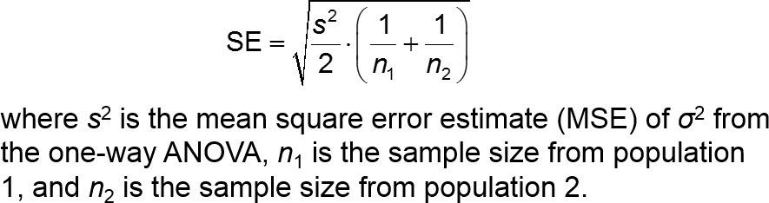
Post Hoc Tests on One-Way Analysis of Variance Perform the Tukey Test (1 of 13)
The computation of the test statistic for Tukey’s test for comparing pairs of means follows the same logic as the test for comparing two means from independent sampling. However, the standard error that is used is

Slide 44
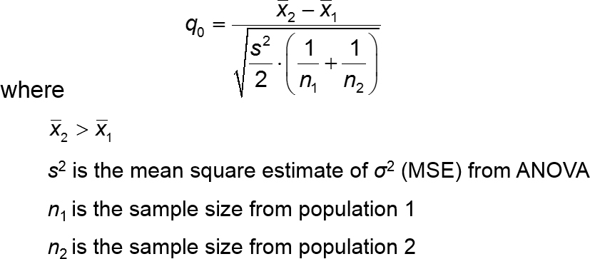
Post Hoc Tests on One-Way Analysis of Variance Perform the Tukey Test (2 of 13)
The test statistic for Tukey’s test when testing H₀: μ₁ = μ₂ versus H₁: μ₁ ≠ μ₂ is given by

Slide 45
Post Hoc Tests on One-Way Analysis of Variance Perform the Tukey Test (3 of 13)
The critical value for Tukey’s test using a familywise error rate α is given by
q_{α, v, k}
where
ν is the degrees of freedom due to error (n − k)
k is the total number of means being compared

Slide 46
Post Hoc Tests on One-Way Analysis of Variance Perform the Tukey Test (4 of 13)
Parallel Example 1: Finding the Critical Value from the Studentized Range Distribution
Find the critical value from the Studentized range distribution with v = 13 degrees of freedom and k = 4 degrees of freedom with a familywise error rate α = 0.01.
Find the critical value from the Studentized range distribution with v = 64 degrees of freedom and k = 6 degrees of freedom with a familywise error rate α = 0.05.

Slide 47
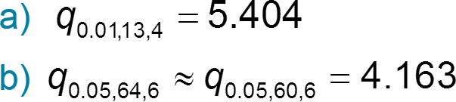
Post Hoc Tests on One-Way Analysis of Variance Perform the Tukey Test (5 of 13)
Solution

Slide 48
Post Hoc Tests on One-Way Analysis of Variance Perform the Tukey Test (6 of 13)
Tukey’s Test
After rejecting the null hypothesis H₀: μ₁ = μ₂ = ··· = μ_{k} the following steps can be used to compare pairs of means for significant differences, provided that
There are k simple random samples from k populations.
The k samples are independent of each other.
The populations are normally distributed.
The populations have the same variance.
Step 1: Arrange the sample means in ascending order.

Slide 49
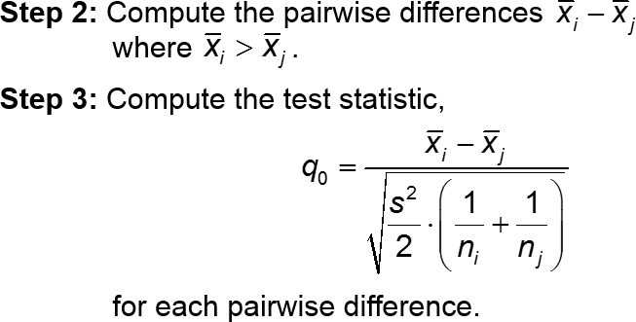
Post Hoc Tests on One-Way Analysis of Variance Perform the Tukey Test (7 of 13)
Tukey’s Test

Slide 50
Post Hoc Tests on One-Way Analysis of Variance Perform the Tukey Test (8 of 13)
Tukey’s Test
Step 4: Determine the critical value, q_{α,v,k}, where α is the level of significance (the familywise error rate).
Step 5: If q₀ ≥ q_{α,v,k}, reject the null hypothesis that H₀: μ_{i} = μ_{j} and conclude that the means are significantly different.
Step 6: Compare all pairwise differences to identify which means differ.

Slide 51
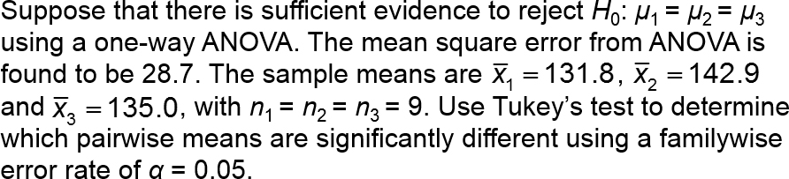
Post Hoc Tests on One-Way Analysis of Variance Perform the Tukey Test (9 of 13)
Parallel Example 2: Performing Tukey’s Test

Slide 52
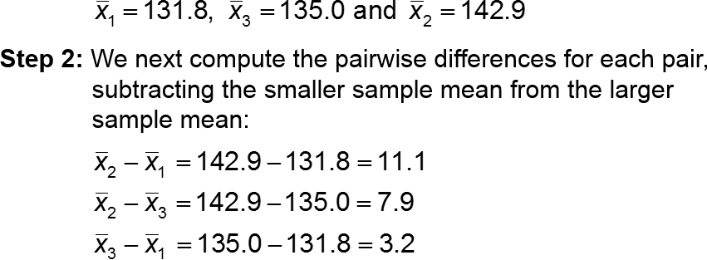
Post Hoc Tests on One-Way Analysis of Variance Perform the Tukey Test (10 of 13)
Solution
Step 1: The means, in ascending order, are

Slide 53
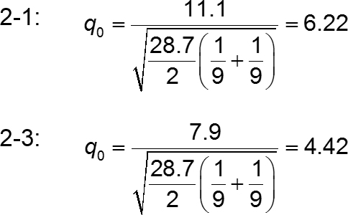
Post Hoc Tests on One-Way Analysis of Variance Perform the Tukey Test (11 of 13)
Solution
Step 3: Compute the test statistic q₀ for each pairwise difference.

Slide 54
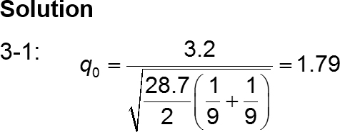
Post Hoc Tests on One-Way Analysis of Variance Perform the Tukey Test (12 of 13)
Step 4: Find the critical value using an α = 0.05 familywise error rate with ν = n − k = 27 − 3 = 24 and k = 3. Then q_{0.05,24,3} = 3.532.

Slide 55

Post Hoc Tests on One-Way Analysis of Variance Perform the Tukey Test (13 of 13)
Solution
Step 5: Since 6.22 and 4.42 are greater than 3.532, but 1.79 is less than 3.532, we reject H₀: μ₁ = μ₂ and H₀: μ₂ = μ₃ but not H₀: μ₁ = μ₃.
Step 6: The conclusions of Tukey’s test are

